Slide 1
Augmented Random Search
CellStrat AI Lab
Anshumaan Dash
2/2/2019

Slide 2
OVERVIEW
‘Simple random search provides a competitive approach to reinforcement learning’, by Horia Mania and Aurelia Guy, University of California, Berkeley in March 20, 2018 [1].
Two different directions proposed for simplifying RL:
Evolution Strategies : derivative-free policy optimization method, to train policies faster [2]
Training linear policies via natural policy gradients to solve the continuous control problems [3]
ARS combines best of both to obtain the simplest model-free RL method yet, a derivative-free optimization algorithm for training linear policies
Simple random search method can match or exceed state-of-the-art sample efficiency on MuJoCo locomotion benchmarks
15 times more computationally efficient than Evolution Strategies, the fastest competing method, which employs several complicated algorithmic elements
Method learns static, linear policies that achieve high rewards on all MuJoCo tasks. No neural networks are used, and yet state-of-the-art performance is still uniformly achieved
Though ARS successfully trains policies for locomotion tasks when hyper-parameters and random seeds are varied, it exhibits a large variance, and learned policies do not uniformly yield high rewards

Slide 3
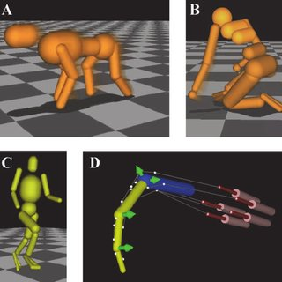
MuJoCo
Multi-Joint dynamics with Contact
Physics engine: Figures need to cross landscapes
Each figure has certain degrees of freedom
One of the most challenging continuous control problems solvable by state-of-the-art RL techniques [4]
Image Source: OpenAIGym

Slide 4
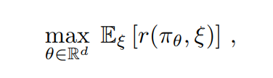
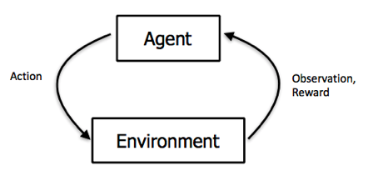
PROBLEM (RL)
Finding policies for controlling dynamical systems with the goal of maximizing average reward on given tasks
where θ -> parametrizes a policy π_{θ}. The random variable ξ encodes the randomness of the environment, i.e., random initial states and stochastic transitions. The value r(π_{θ}, ξ) is the reward achieved by the policy π_{θ} on one trajectory generated from the system.
(1)

Slide 5

RANDOM SEARCH
Problem formulation (1) aims to optimize reward by directly optimizing over the policy parameters θ
Exploring the parameter space rather than the action space, renders RL training equivalent to derivative-free optimization with noisy function evaluations
Random Search: One of the simplest and oldest optimization methods for derivative-free optimization [5]
Random search chooses a direction uniformly at random on the sphere in parameter space, and then optimizes the function along that direction
Basic random search simply computes a finite difference approximation along the random direction and then takes a step along this direction without using a line search
ARS updates the parameters θ of a policy π_{θ} and exploits update directions of the form:
for two independent and identically distributed random variables ξ₁ and ξ₂, ν a positive real number, and δ a zero mean Gaussian vector
Such an update (increment) is an unbiased estimator of the gradient with respect to θ
BRS is called Bandit Gradient Descent [6]

Slide 6
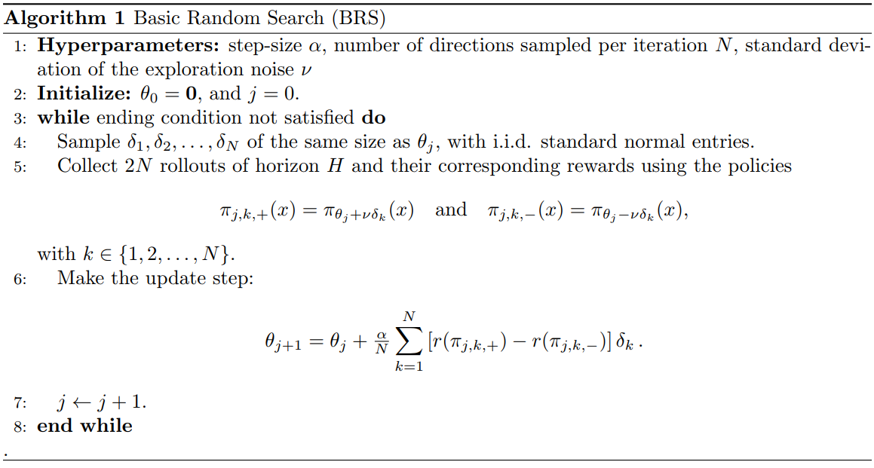
Basic Random Search (BRS)

Slide 7

AUGMENTED RANDOM SEARCH
For application to continuous control, the basic random search method is augmented with three simple features:
Scale each update step by the standard deviation of the rewards collected for computing that update step : σ_{R}
Normalize the system’s states by online estimates of their mean and standard deviation
Discard from the computation of the update steps the directions that yield the least improvement of the reward

Slide 8
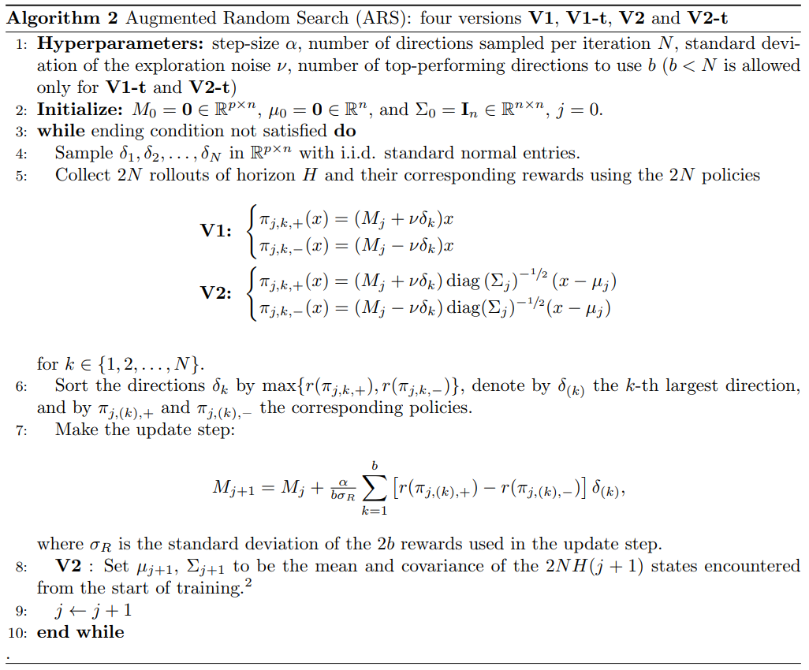
AUGMENTED RANDOM SEARCH (CNTD)

Slide 9
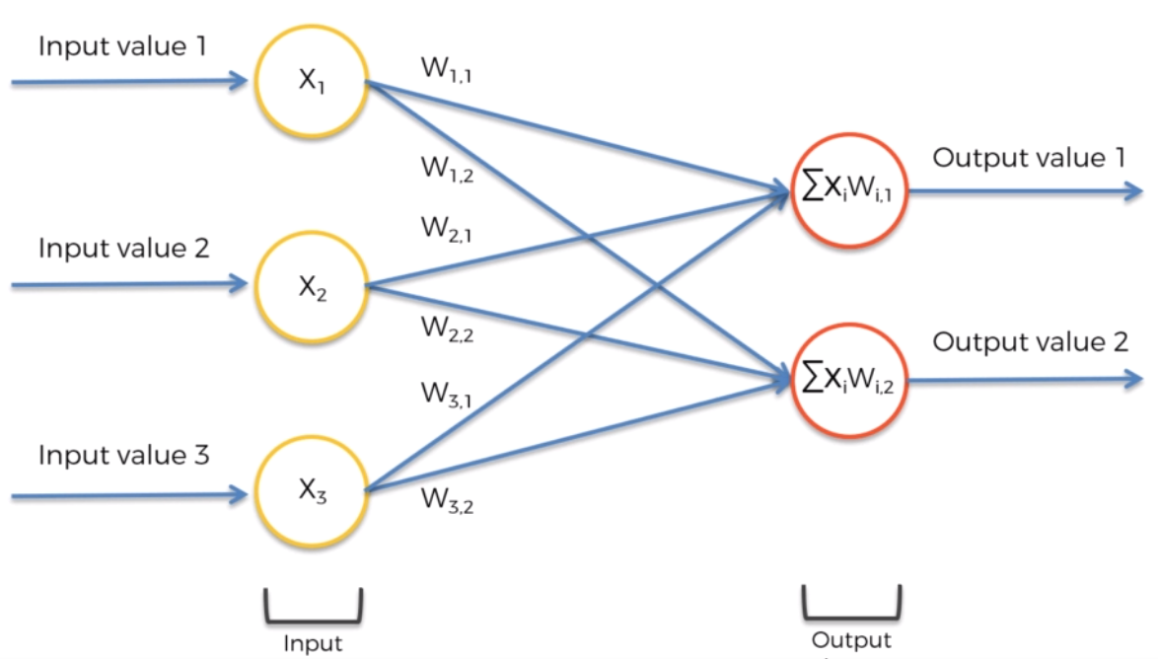
PERCEPTRON
Image Source: www.superdatascience.com

Slide 10
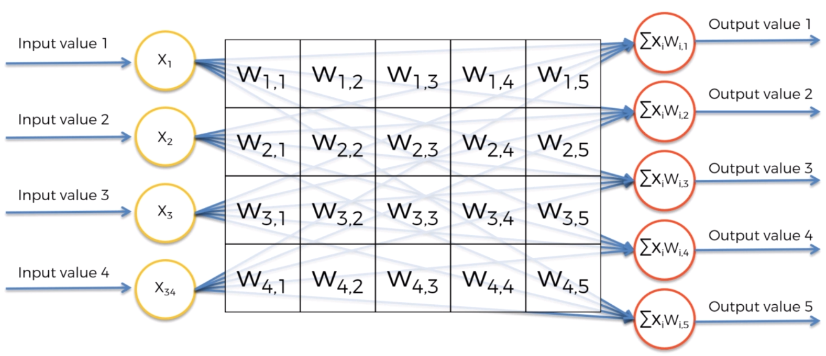
PERCEPTRON (CNTD)
Image Source: www.superdatascience.com
Y = W^{T}X + b

Slide 11
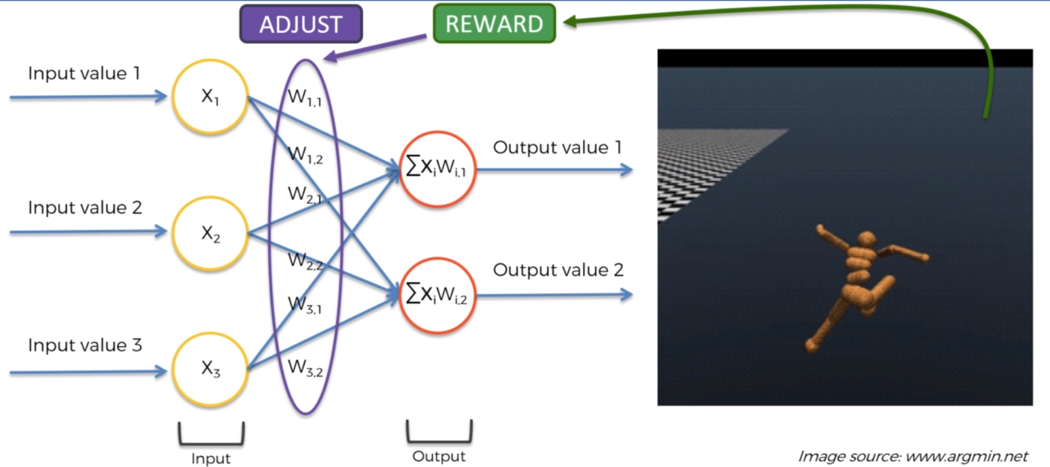
MAXIMIZING REWARDS
Image Source: www.superdatascience.com

Slide 12
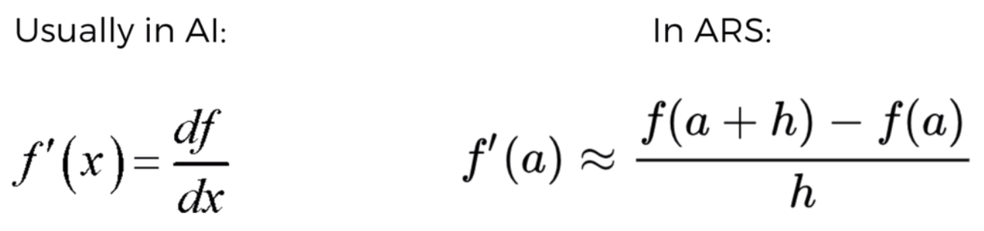

MAXIMIZING REWARDS (CNTD): Method of Finite Differences
Derivative-free optimization:

Slide 13
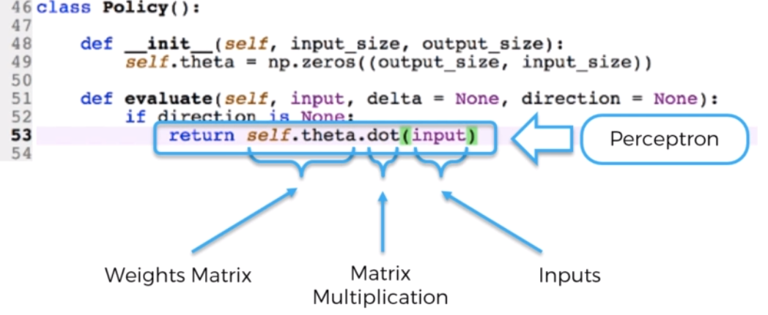
PERCEPTRON IN ACTION

Slide 14
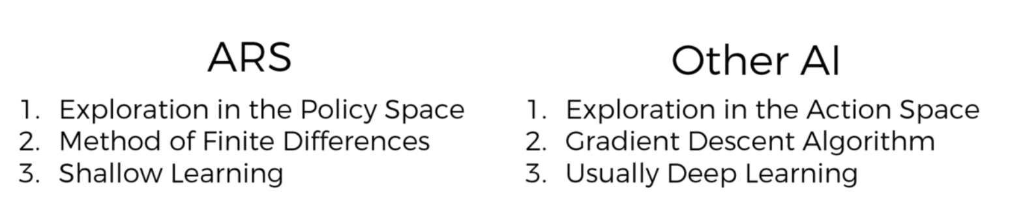
COMPARISON

Slide 15
References
[1] Horia Mania, Aurelia Guy. Simple random search provides a competitive approach to reinforcement learning. arXiv:1803.07055, 2018.
[2] T. Salimans, J. Ho, X. Chen, and I. Sutskever. Evolution strategies as a scalable alternative to reinforcement learning. arXiv:1703.03864, 2017.
[3] A. Rajeswaran, K. Lowrey, E. Todorov, and S. Kakade. Towards generalization and simplicity in continuous control. arXiv:1703.02660, 2017.
[4] T. Salimans, J. Ho, X. Chen, and I. Sutskever. Evolution strategies as a scalable alternative to reinforcement learning. arXiv preprint arXiv:1703.03864, 2017.
[5] J. Matyas. Random optimization. Automation and Remote control, 26(2):246–253, 1965.
[6] A. D. Flaxman, A. T. Kalai, and H. B. McMahan. Online convex optimization in the bandit setting: gradient descent without a gradient. Proceedings of the sixteenth annual ACM-SIAM symposium on Discrete algorithms, pages 385–394, 2005.

